Slide 1
CONFORMAL TRANSFORMATION
By: 1DT19CS023, Aryan

Slide 2
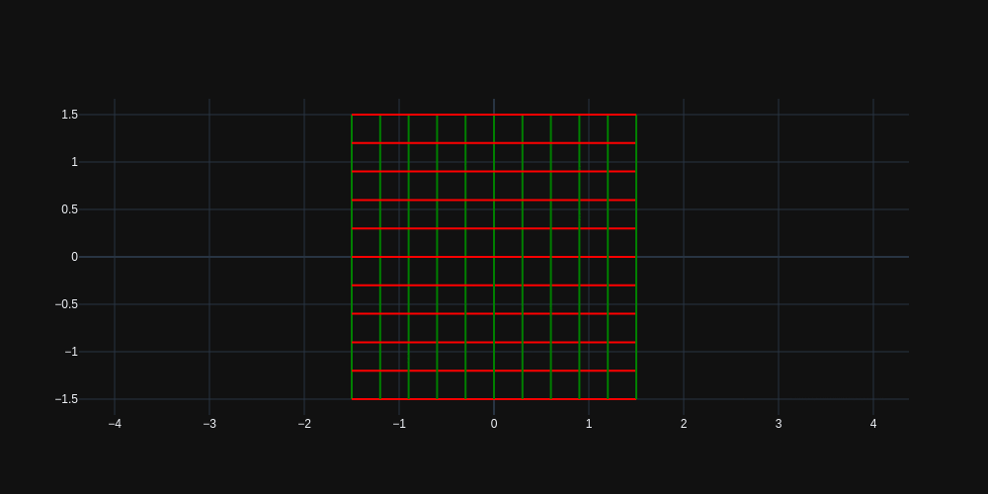
Conformal Mapping ?
A conformal map is a function which preserves the angles.
More formally, a map $w=f(z)$ is called conformal (or angle-preserving) at $z_{0}$ if it preserves oriented angles between curves through $z_{0}$, as well as their orientation, i.e. direction.
$$w=e^{z}$$

Slide 3
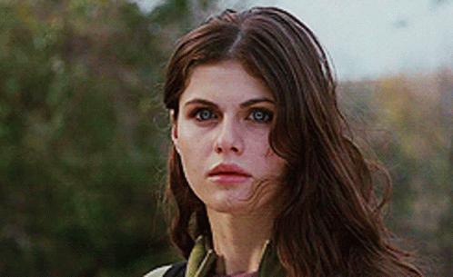
Conformal mapping-based 3D face recognition
Face is potentially the best biometrics for people identification related applications for its non instructiveness, contactless and socially well acceptance.
The proposed approach makes use of conformal UV parameterization for mapping purpose and Shape Index decomposition for similarity measurement.

Slide 4
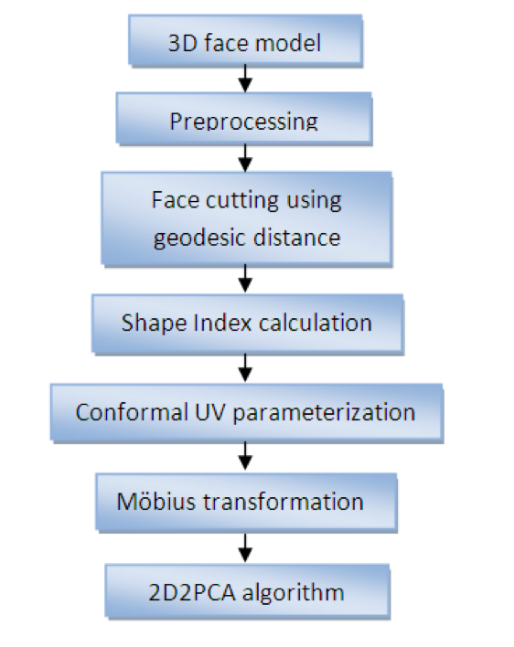
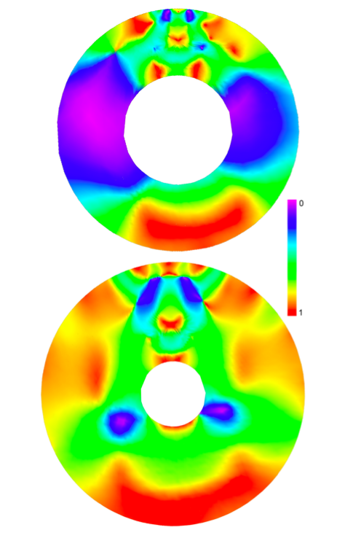
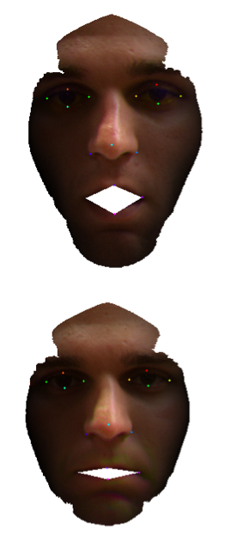
Flowchart
Conformal Map created from parametrized UV coordinates, colors represent Shape Index value. The mouth part has been mapped to the inner hole while outer face boundary to the boundary of circle.
Geodesic face cutting result with zero distance
between lips in presence
of expression.
Rasterized images are used as an input for $(2D)^{2}PCA$ recognition algorithm.

Slide 5
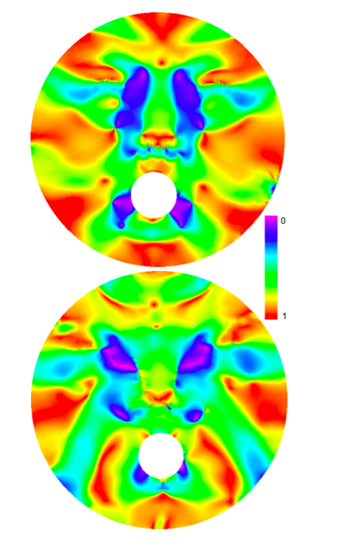


What about Facial Expressions ??
Möbius Transformation carried on UV conformal coordinates.
Following formula is used : $f(θ,z_{0},z)=e^{iθ}\frac{(z-z_{0})}{1-{\overset{˜}{z}}_{0}z}$,
where $z=(u+iv)$ complex number within unit disk.
$θ,z_{0}$ and $z$ are parameters.
Conformal maps transformed by Möbius
Transformation with centre point in the nose tip
🤔😂🥲😍😜😋☹️😡😐🙄

